Slide 1
Developing Apps for Touch and Mobile Devices

Slide 2
Objectives
In this session, you will learn to:
  Identify the fundamentals of cross-platform app development
  Work with Apache Cordova

Slide 3



Introduction to Cross-Platform App Development

Slide 4

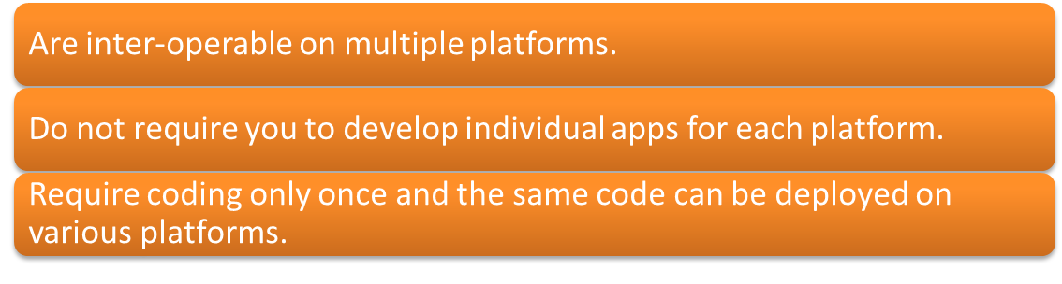
Introduction to Cross-Platform App Development (Contd.)
To develop a mobile app that can run on multiple platforms, such as Android, Windows Phone, and iOS, you need to:
Cross-platform apps:

Slide 5
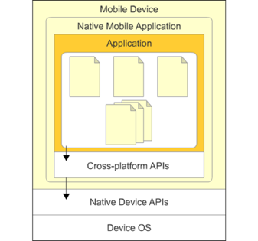
Cross-Platform Tools
Cross-platform tools are the development tools that enable a developer to develop an app only once and then deploy it on multiple platforms.
These tools eradicate the need to develop individual apps for each platform.
You only need to know the technology associated with the cross-platform tool that you are using.
The app is developed only once and is then packaged into a native app for every supported platform using the special aids provided by the cross-platform tools.
Device Interaction

Slide 6
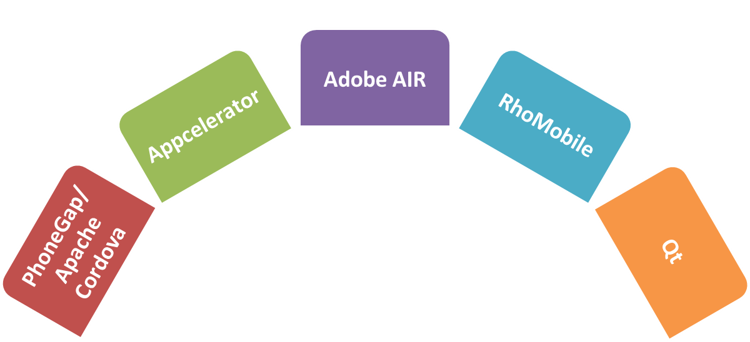
Cross-Platform Tools (Contd.)
A cross-platform tool provides common APIs that help in accessing the native APIs of each platform.
Some popular cross-platform app development tools are:
Cross-Platform Tools

Slide 7
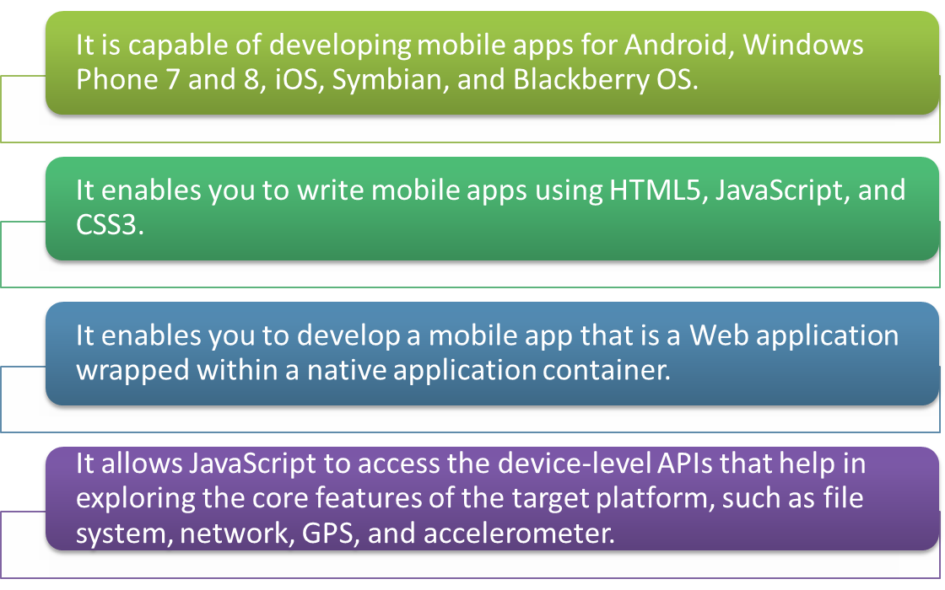
Cross-Platform Tools (Contd.)
PhoneGap/Apache Cordova
PhoneGap is the most widely used tool to develop cross-platform apps.
The features of PhoneGap are:

Slide 8
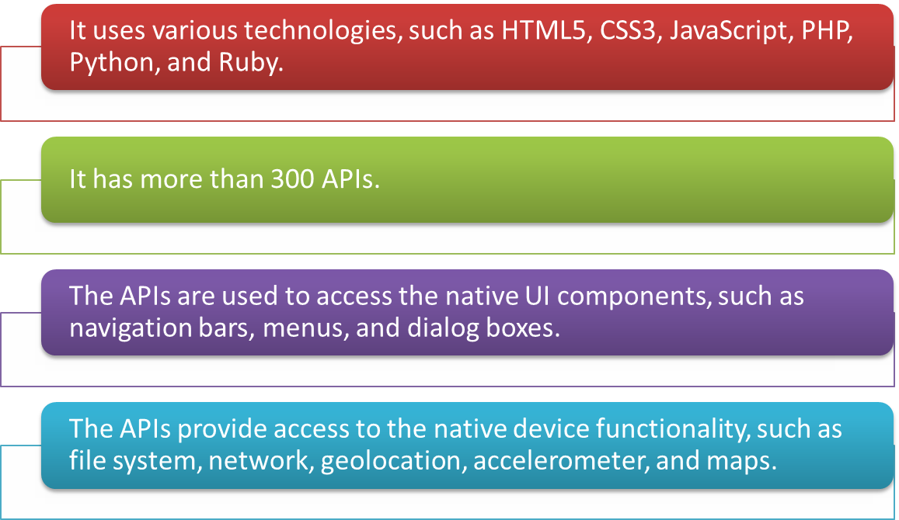
Cross-Platform Tools (Contd.)
Appcelerator
The features of Appcelerator are:

Slide 9
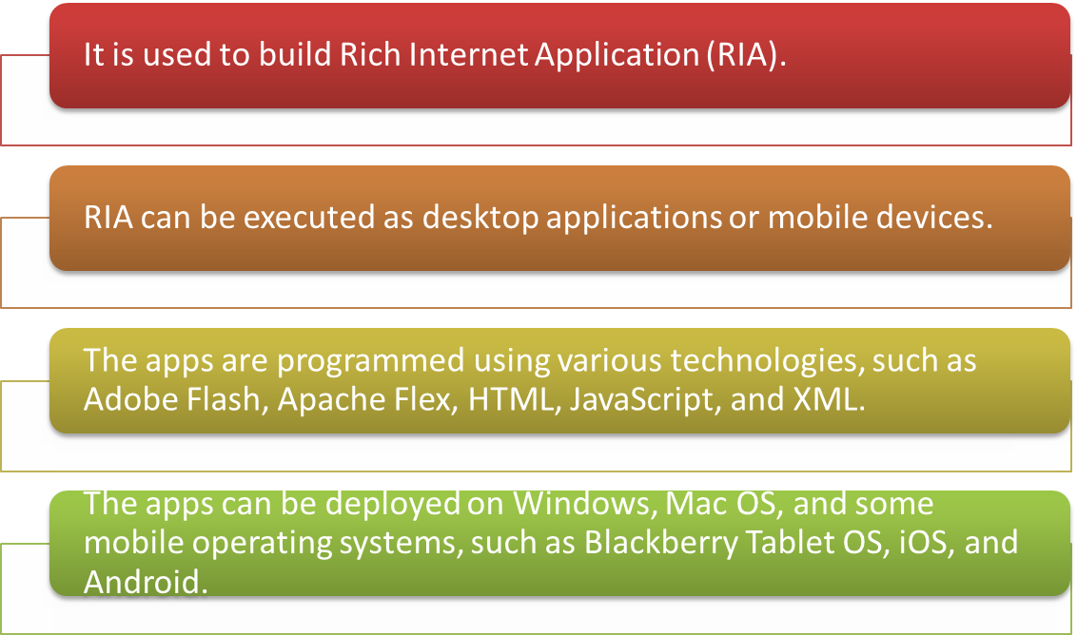
Cross-Platform Tools (Contd.)
Adobe AIR
Adobe AIR, also known as Adobe Integrated Runtime, is a cross-platform app development tool developed by Adobe Systems.
The features of Adobe AIR are:

Slide 10
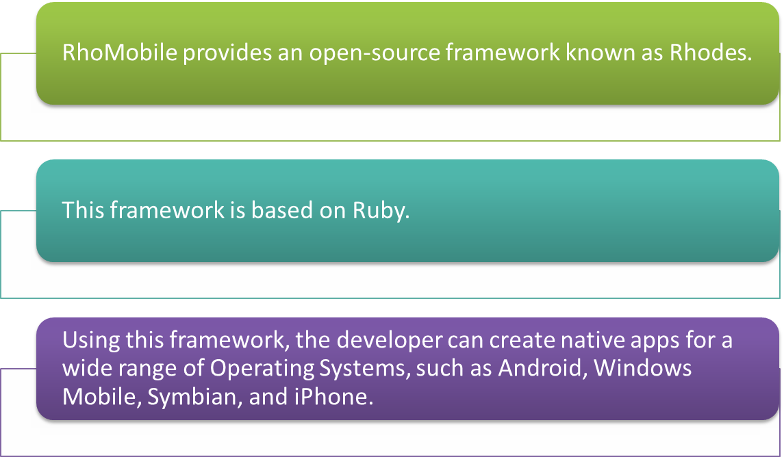
Cross-Platform Tools (Contd.)
RhoMobile
The features of RhoMobile are:

Slide 11
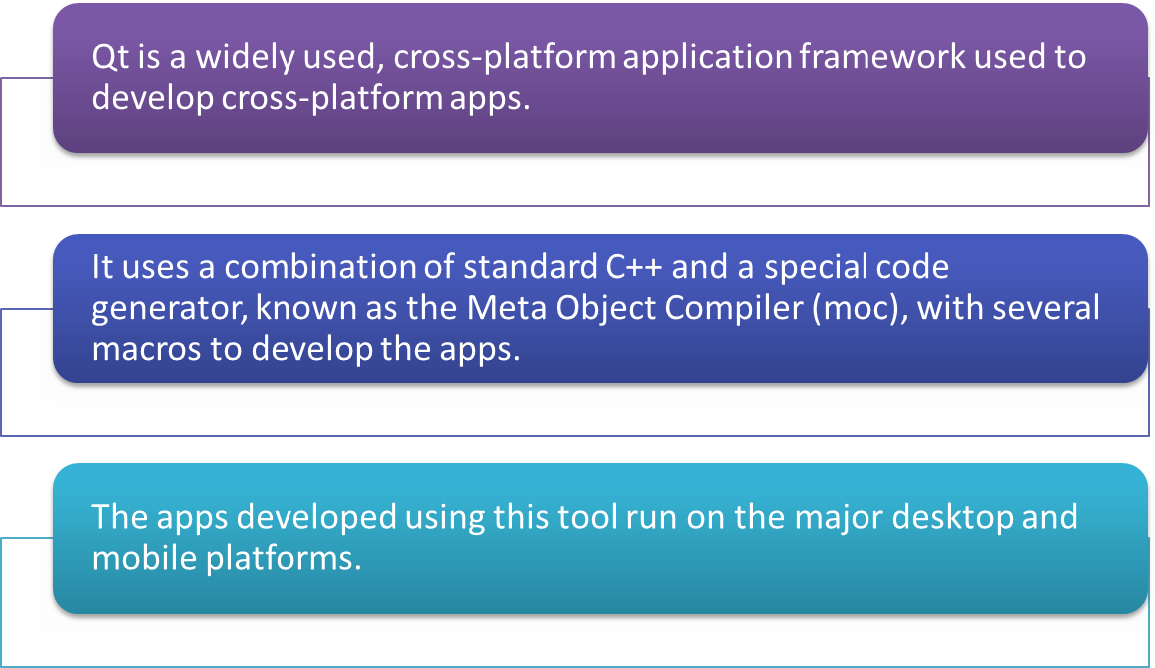
Cross-Platform Tools (Contd.)
Qt
The features of Qt are:

Slide 12
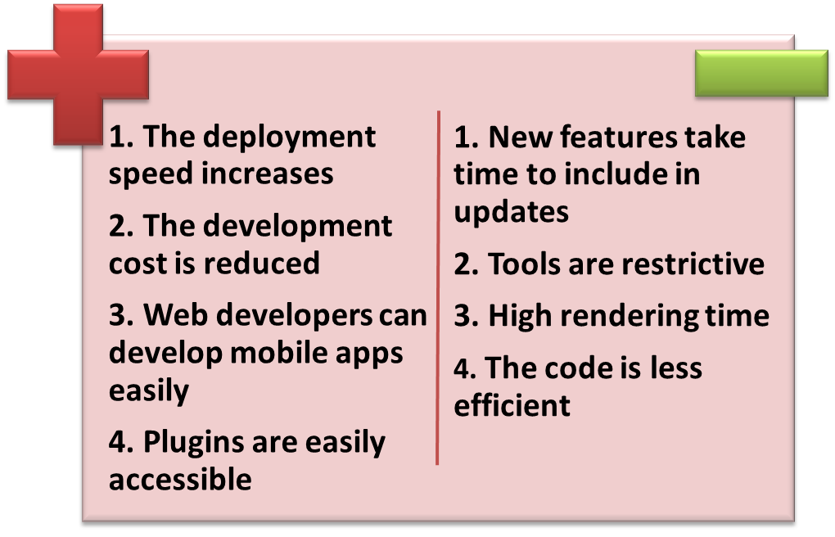
Pros and Cons of Using Cross-Platform Tools
The various pros and cons of using cross-platform tools for app development are:

Slide 13

Just a Minute
In which one of the following cross-platform tools is the framework based on Ruby?
Appcelerator
Adobe AIR
RhoMobile
Qt
Answer:
RhoMobile

Slide 14
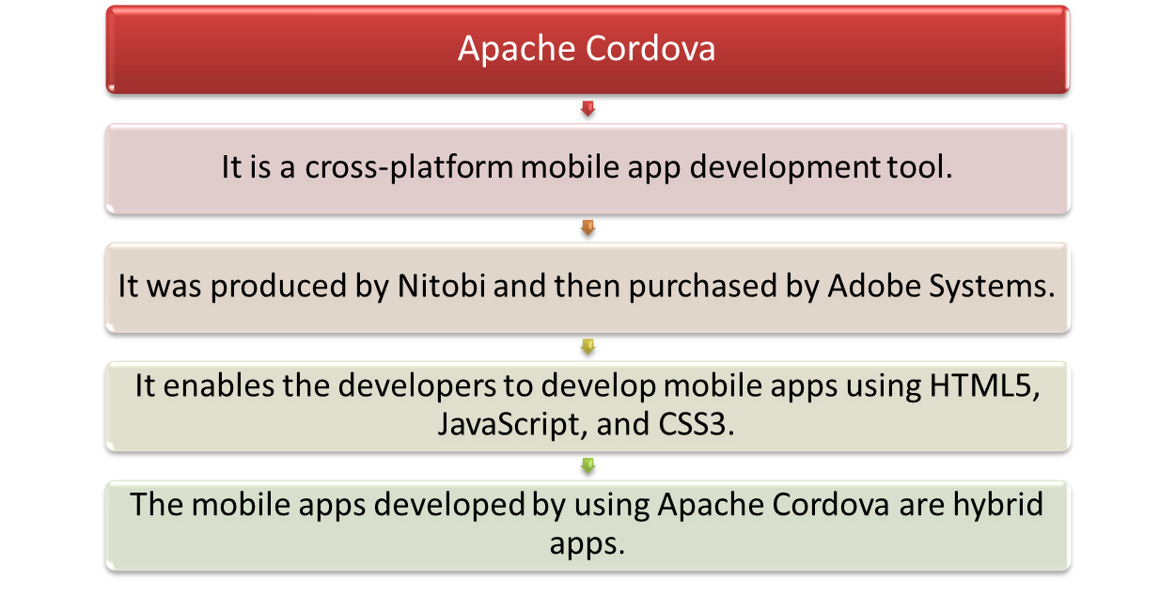
Working with Apache Cordova

Slide 15
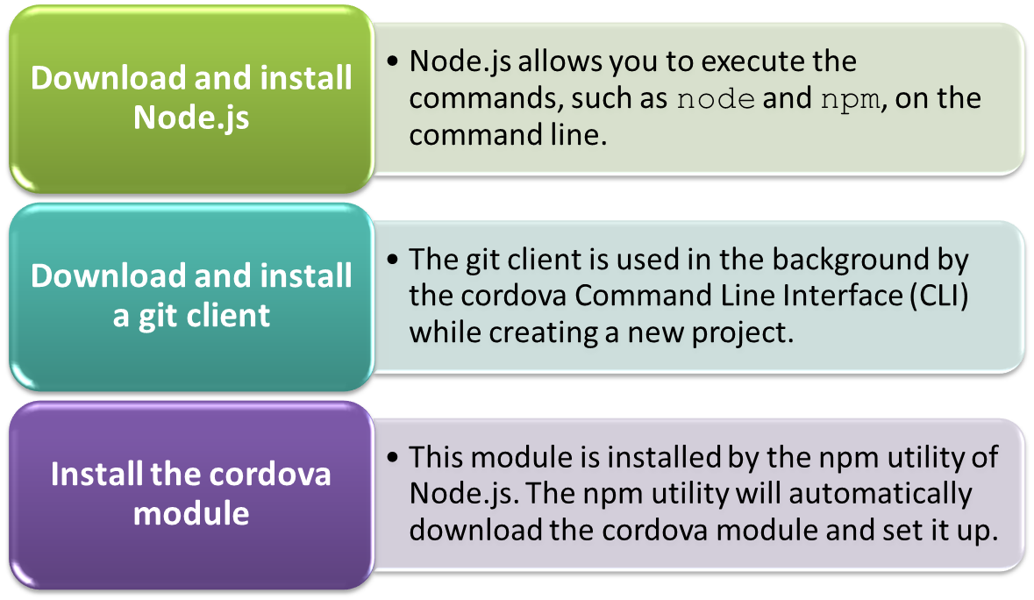
Installing Apache Cordova
To install Apache Cordova, you need to perform the following tasks:

Slide 16
Task 10.1: Downloading and Installing Node.js

Slide 17
Task 10.2: Downloading and Installing a git Client

Slide 18
Task 10.3: Installing the Cordova Module

Slide 19
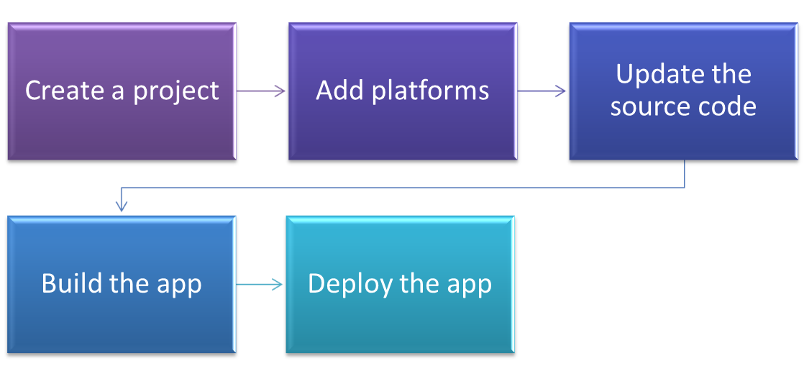
Using Apache Cordova to Create Cross-Platform Apps
To develop a cross-platform mobile app, you need to have extensive knowledge of the development of mobile apps on each platform.
Apache Cordova enables you to create a project in which you need to code in HTML5, JavaScript, and CSS3.
To create a cross-platform app by using Apache Cordova, perform the following tasks:

Slide 20
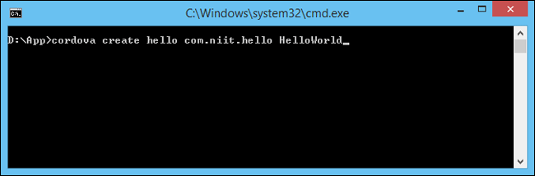
Using Apache Cordova to Create Cross-Platform Apps (Contd.)
Creating a Project
To create a new project, execute the following command on the command line, as shown in the following figure.
Creating a New Project Using Apache Cordova

Slide 21
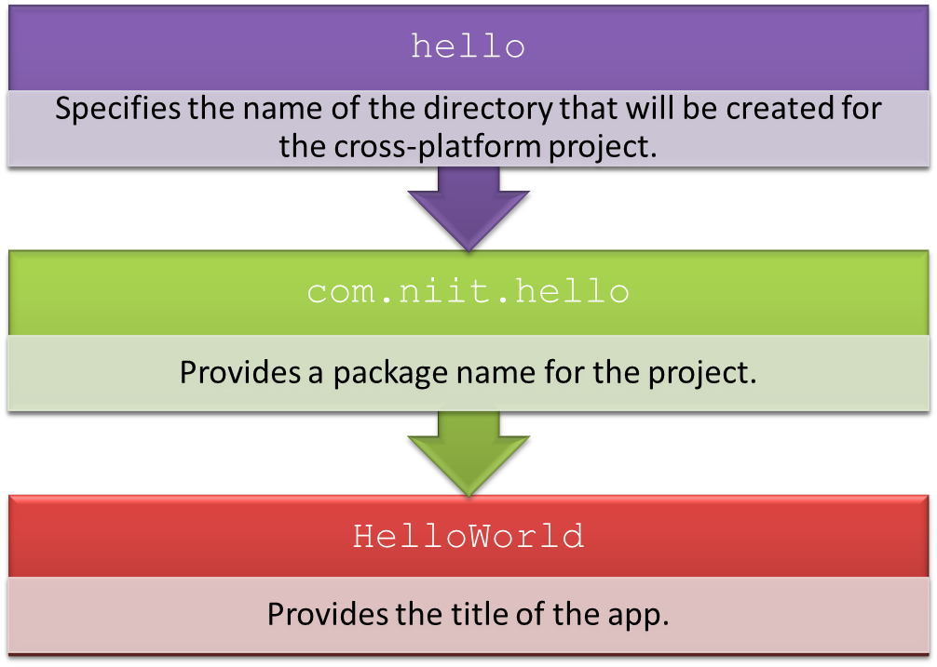
Using Apache Cordova to Create Cross-Platform Apps (Contd.)
In the preceding command, the three arguments are:

Slide 22
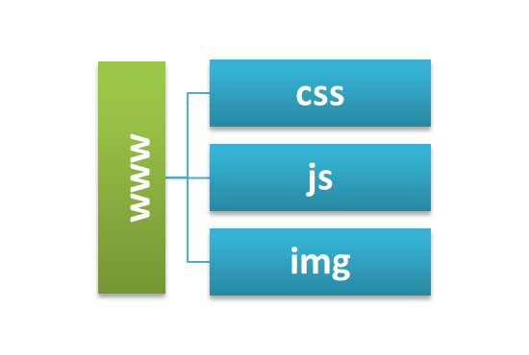

Using Apache Cordova to Create Cross-Platform Apps (Contd.)
The create command creates a new project that contains a Web application project for cross-platform mobile app.
The config.xml file includes the metadata that helps in the generation and distribution of the application.
Structure of the www Directory
Project Structure of the App

Slide 23
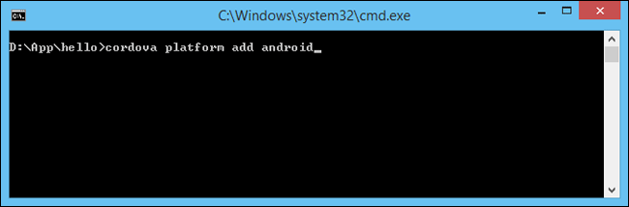
Using Apache Cordova to Create Cross-Platform Apps (Contd.)
Adding Platforms
The project created using the cordova CLI is a simple Web application.
To make a native app for a specific platform, you need to add a platform to the project.
To add the Android platform to a project, you need to execute the following statement on the command line, as shown in the following figure.
The following command gets a list of platforms installed in the
project and the platforms that are available to install in the
project:
  cordova platforms ls

Slide 24

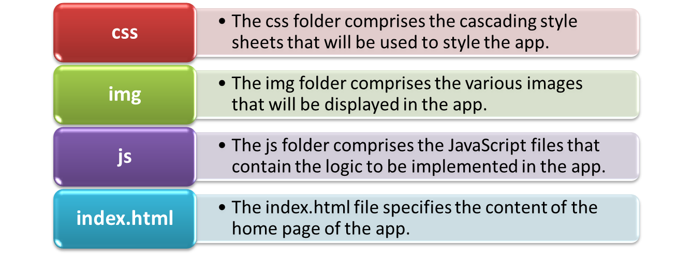
Using Apache Cordova to Create Cross-Platform Apps (Contd.)
Updating the Source Code
You need to write the code of your app in the various files inside the www folder present in the base directory of your project.
The www folder comprises the following directories and files:
Directory Structure of the www Folder

Slide 25
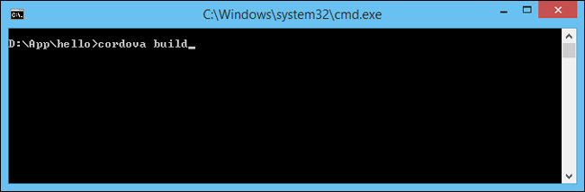

Using Apache Cordova to Create Cross-Platform Apps (Contd.)
Building the App
The app is ready to be tested on a device or emulator.
You need to build the app by executing the following command on the command line, as shown in the following figure.
To build the project for a specific platform, you need to execute the build command, as shown in the following figure.
Building the App
Building the App for a Specific Platform

Slide 26
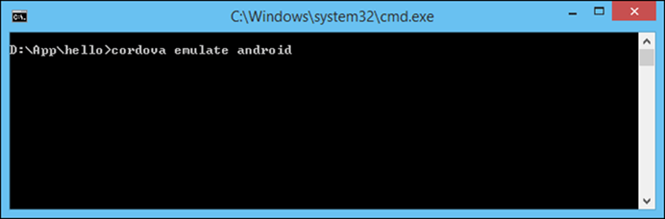
Using Apache Cordova to Create Cross-Platform Apps (Contd.)
Deploying the App
After building the app, you deploy it on an emulator or device.
This can be done by executing the following command on the command line, as shown in the following figure.
The preceding command will deploy the project on an emulator or
Android device connected to the system.
Deploying the App

Slide 27
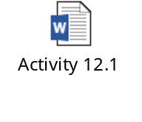
Activity 10.1: Creating a Cross-Platform App Using Apache Cordova
Problem Statement:
Solution:
To complete this activity, you need to perform the following steps:
  Open project.
  Add the message dialog box.
  Execute the app and verify the output.

Slide 28
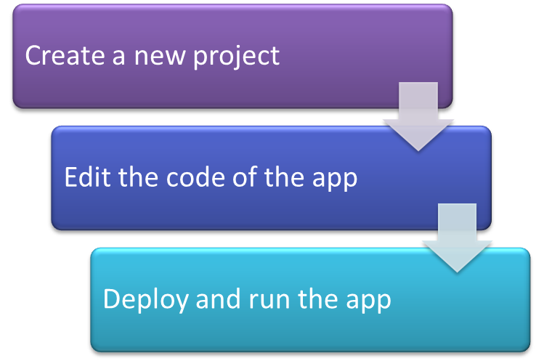
Cross-Platform Development in Visual Studio Using Apache Cordova
Comparing Different Types of Apps
Visual Studio 2013 with Update 4 provides an integrated extension for cross-platform app development using Apache Cordova.
By using this extension, all the required software applications and SDKs are installed automatically.
To create a cross-platform app using Visual Studio, perform the following tasks:

Slide 29
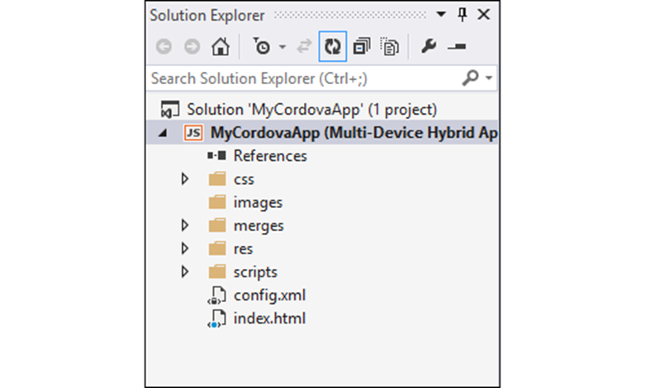
Cross-Platform Development in Visual Studio Using Apache Cordova (Contd.)
Creating a New Project
To create a multi-device hybrid app, Microsoft Visual Studio provides a Blank App template, which creates a project structure, as shown in the following figure.
Project Structure of a Blank App

Slide 30
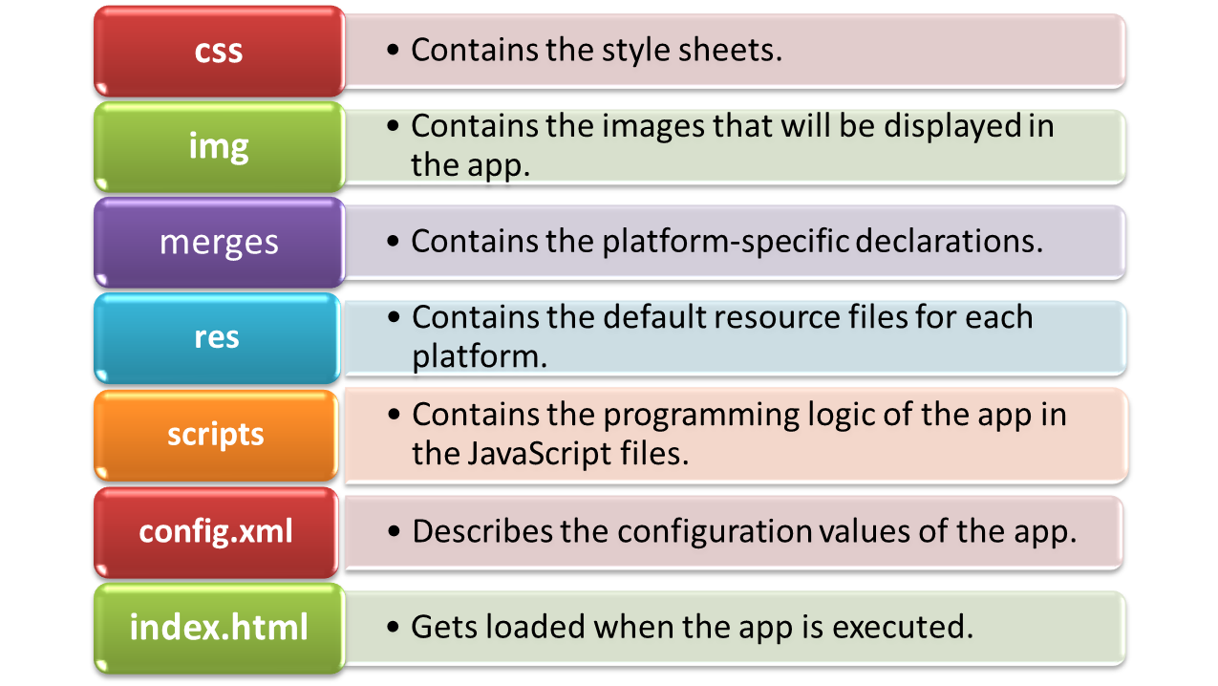
Cross-Platform Development in Visual Studio Using Apache Cordova (Contd.)
The project structure of a blank App contains the following folders and files:

Slide 31
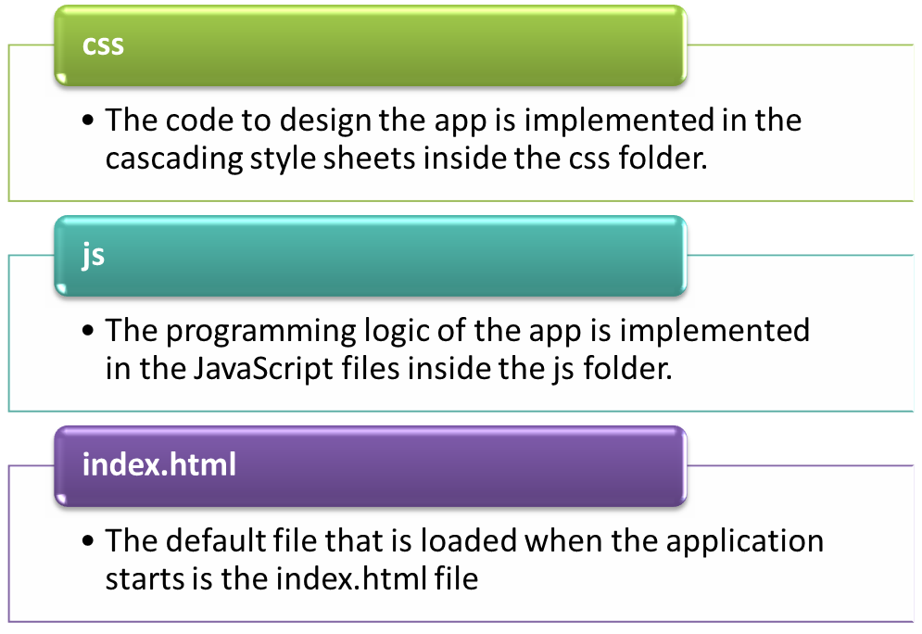
Cross-Platform Development in Visual Studio Using Apache Cordova (Contd.)
Editing the Code of the App
To implement various functionalities in your app, you need to edit the default code in the app.

Slide 32
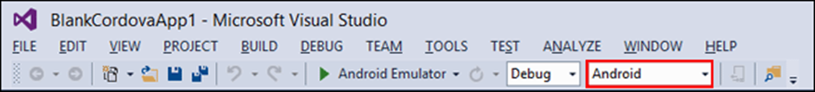
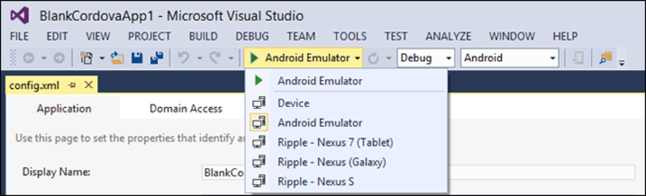
Cross-Platform Development in Visual Studio Using Apache Cordova (Contd.)
Deploying and Running the App
To deploy and run your app, select the target platform from the Solution Platforms list, as shown in the following figure.
Select the device from the device list, as shown in the following figure.
Target Platform in Visual Studio
Selecting the Device Type

Slide 33
Summary
In this session, I learned that:

